Slide 1
Empirical estimation models

Slide 2
Empirical Estimation Models
Estimation models for computer software use empirically derived formulas to predict effort as a function of LOC or FP
Resultant values computed for LOC or FP are entered into an estimation model
The empirical data for these models are derived from a limited sample of projects
Model is tested by comparing the estimated values against actual values after completion of software.

Slide 3
Empirical Estimation Models
General form:
exponent
effort = tuning coefficient * size
usually derived
empirically
as person-months
derived
of effort required
usually LOC but
may also be
either a constant or
function point
a number derived based
on complexity of project

Slide 4
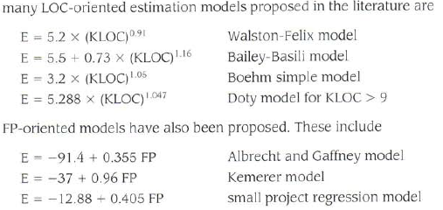
Estimation Models

Slide 5
COCOMO II Model
Stands for COnstructive COst MOdel
Introduced by Barry Boehm in 1981 in his book “Software Engineering Economics”
Became one of the well-known and widely-used estimation models in the industry
It has evolved into a more comprehensive estimation model called COCOMO II
COCOMO II is actually a hierarchy of three estimation models
As with all estimation models, it requires sizing information. Its LOC based model

Slide 6
COCOMO II Model (contd..)
Application composition model - Used during the early stages of software engineering when the following are important
Prototyping of user interfaces
Consideration of software and system interaction
Assessment of performance
Evaluation of technology maturity
Early design stage model – Used once requirements have been stabilized and basic software architecture has been established
Post-architecture stage model – Used during the construction of the software

Slide 7
COCOMO : Development modes
Organic Mode: The project is developed in a familiar, stable environment, and the product is similar to previously developed products. The product is relatively small, and requires little innovation.
Semidetached Mode: The project is developed by experienced and inexperienced staff. The project's characteristics are intermediate between Organic and Embedded.
Embedded Mode: The project is characterized by tight, inflexible constraints and interface requirements. Experience level is low. So, an embedded mode project will require a great deal of innovation.

Slide 8
Modes

Slide 9
Modes (cont..)

Slide 10
Effort Computation
The Basic COCOMO model computes effort as a function of program size. The Basic COCOMO equation is:
E = a(KLOC)^b
Effort for three modes of Basic COCOMO.
Mode | a | b
Organic | 2.4 | 1.05
Semi-detached | 3.0 | 1.12
Embedded | 3.6 | 1.20

Slide 11

Example

Slide 12
Effort Computation
The intermediate COCOMO model computes effort as a function of program size and a set of cost drivers. The Intermediate COCOMO equation is:
E = a(KLOC)^b*EAF
Effort for three modes of intermediate COCOMO.
Mode | a | b
Organic | 3.2 | 1.05
Semi-detached | 3.0 | 1.12
Embedded | 2.8 | 1.20

Slide 13
Effort computation(cont..)
Effort Adjustment Factor
Cost Driver
Very
Low
Low
Nominal
High
Very
High
Extra
High
Required Reliability
.75
.88
1.00
1.15
1.40
1.40
Database Size
.94
.94
1.00
1.08
1.16
1.16
Product Complexity
.70
.85
1.00
1.15
1.30
1.65
Execution Time Constraint
1.00
1.00
1.00
1.11
1.30
1.66
Main Storage Constraint
1.00
1.00
1.00
1.06
1.21
1.56
Virtual Machine Volatility
.87
.87
1.00
1.15
1.30
1.30
Comp Turn Around Time
.87
.87
1.00
1.07
1.15
1.15
Analyst Capability
1.46
1.19
1.00
.86
.71
.71
Application Experience
1.29
1.13
1.00
.91
.82
.82
Programmers Capability
1.42
1.17
1.00
.86
.70
.70
Virtual machine Experience
1.21
1.10
1.00
.90
.90
.90
Language Experience
1.14
1.07
1.00
.95
.95
.95
Modern Prog Practices
1.24
1.10
1.00
.91
.82
.82
SW Tools
1.24
1.10
1.00
.91
.83
.83
Required Dev Schedule
1.23
1.08
1.00
1.04
1.10
1,10

Slide 14


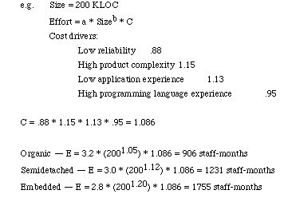
Example

Slide 15
Software Development Time
Development Time Equation Parameter Table:
Development Time, TDEV = c * (E)^d
Number of Personnel, NP = E / TDEV
Mode | c | d
Organic | 2.5 | 0.38
Semi-detached | 2.5 | 0.35
Embedded | 2.5 | 0.32

Slide 16
Example: Basic COCOMO
1.Consider one module of student information system is to be developed. LOC is estimated to be 8,000. Compute how many programmer months and programmers will be required using Basic COCOMO model.

Slide 17
Answer:
E = 2.4 (8)^ 1.05
=18 programmer month
TDEV = 2.5 (18)^ 0.38
= 6 months
NP = E/TDEV
=18/6=3 programmers

Slide 18
Example : Intermediate COCOMO
System for office automation must be designed. Four modules in system are data entry, data update, query and report generator. Project fall in organic category. Sizes for modules are as:
Data entry:0.6 KDSI
Data update:0.6 KDSI
Query:0.8 KDSI
Report generator: 1.00 KDSI.
Assume all factors had nominal rating. Find out overall effort estimate

Slide 19
Answer:
Total KDSI= 0.6+0.6+0.8+1.0=3 KDSI
EAF = product of all factors i.e. 1.00
Ei = a(KDSI)^b
= 3.2(3)^1.05
= 10.14 PM
E = Ei * EAF
= 10.14 * 1.00
= 10.14 PM

Slide 20
COCOMO II models require sizing information.
Three different sizing options are available as part of the model hierarchy:
Object points
Function points
Lines of source code.
The COCOMO II application composition model uses object points.
Estimation models (using FP and KLOC) are also available as part of COCOMO II.
Like function points, the object point is an indirect software measure that is computed using counts of the number of
Screens (at the user interface),
Reports, and
Components likely to be required to build the application.
Each object instance (e.g., a screen or report) is classified into one of three complexity levels (i.e., simple, medium, or difficult)

Slide 21
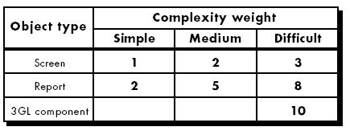
Complexity Weights

Slide 22
Once complexity is determined, the number of screens, reports, and components are weighted according to Table.
Object point count is then determined by multiplying the original number of object instances by the weighting factor in Table and summing to obtain a total object point count.
When component-based development or general software reuse is to be applied, the percent of reuse (%reuse) is estimated and the object point count is adjusted:
NOP = (object points) x [(100 - %reuse)/100]
NOP is defined as new object points.
To derive an estimate of effort based on the computed NOP value, a “productivity rate” must be derived.
PROD = NOP/person-month
Notes:
Complexity weight can be measure on source of the client and server data tables that are required to generate the screen or report and the number of views or sections presented as part of the screen or report.

Slide 23
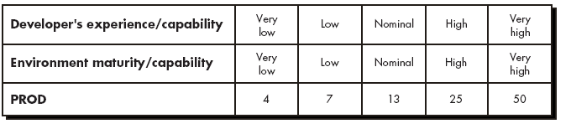
Table represents the productivity rate for different levels of developer experience and development environment maturity.
Once the productivity rate has been determined, an estimate of project effort can be derived as
Estimated effort = NOP/PROD

Slide 24
Make/Buy Decision
It is often more cost effective to acquire rather than develop software
Managers have many acquisition options
Software may be purchased (or licensed) off the shelf
“Full-experience” or “partial-experience” software components may be acquired and integrated to meet specific needs
Software may be custom built by an outside contractor to meet the purchaser’s specifications
The make/buy decision can be made based on the following conditions
Will the software product be available sooner than internally developed software?
Will the cost of acquisition plus the cost of customization be less than the cost of developing the software internally?
Will the cost of outside support (e.g., a maintenance contract) be less than the cost of internal support?
☺

Slide 25
The Make-Buy Decision Tree

Slide 26
Computing Expected Cost
expected cost =
(path probability) x (estimated path cost)
i
i
For example, the expected cost to build is:
expected cost = 0.30 ($380K) + 0.70 ($450K)
build
= $429 K
similarly,
expected cost = $382K
reuse
expected cost = $267K
buy
expected cost = $410K
contr

